Slide 1

Chemical Gradients, Fluid Mixing and the Influence on Biological Diversity in Yellowstone National Park
Brianna Orrill
Alta Howells, Everett Shock
School of Earth and Space Exploration

Slide 2
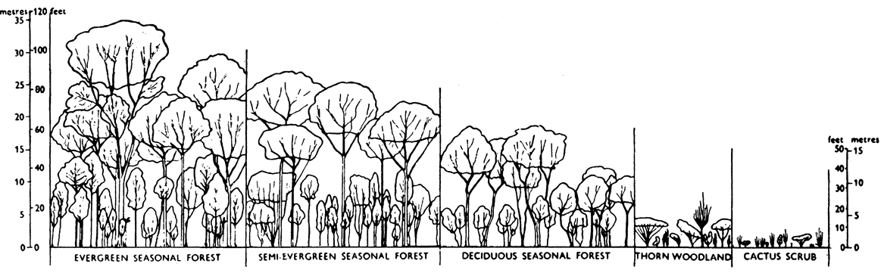
Large scale gradients influence biological diversity
Adapted from Beard, 1955

Slide 3
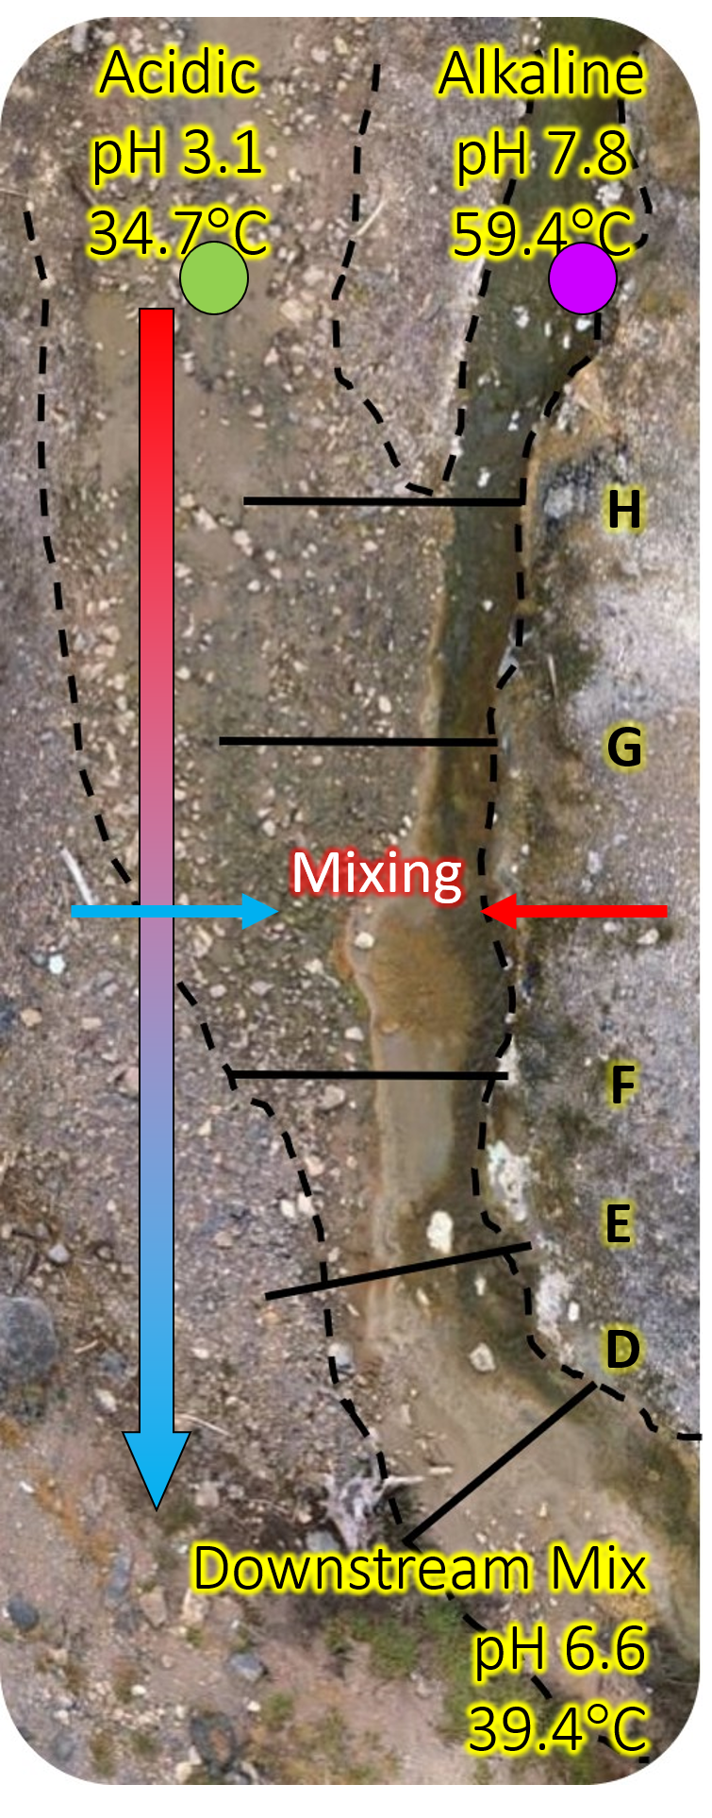
Chemical and temperature gradients are both driving forces for the environment and inhabitants.
Study a small-scale system and the local ecological response to geochemical gradients
Collect information on ecological development and biodiversity which can then be applied to larger systems on Earth or off-planet.
2m
Notes:
Set up
Explain system

Slide 4
Objectives
Understand the chemical gradient present
Determine the mixing model for the system and impact on chemistry
Understand how both mixing and the chemical gradient play a role in the biology present and its diversity

Slide 5
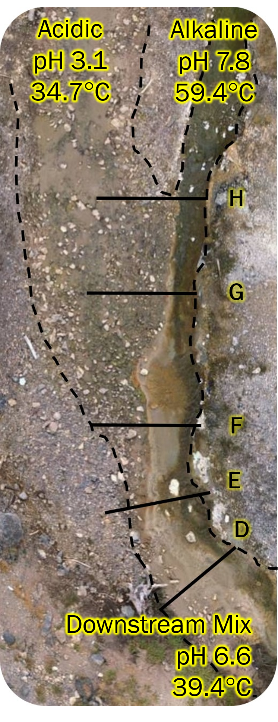
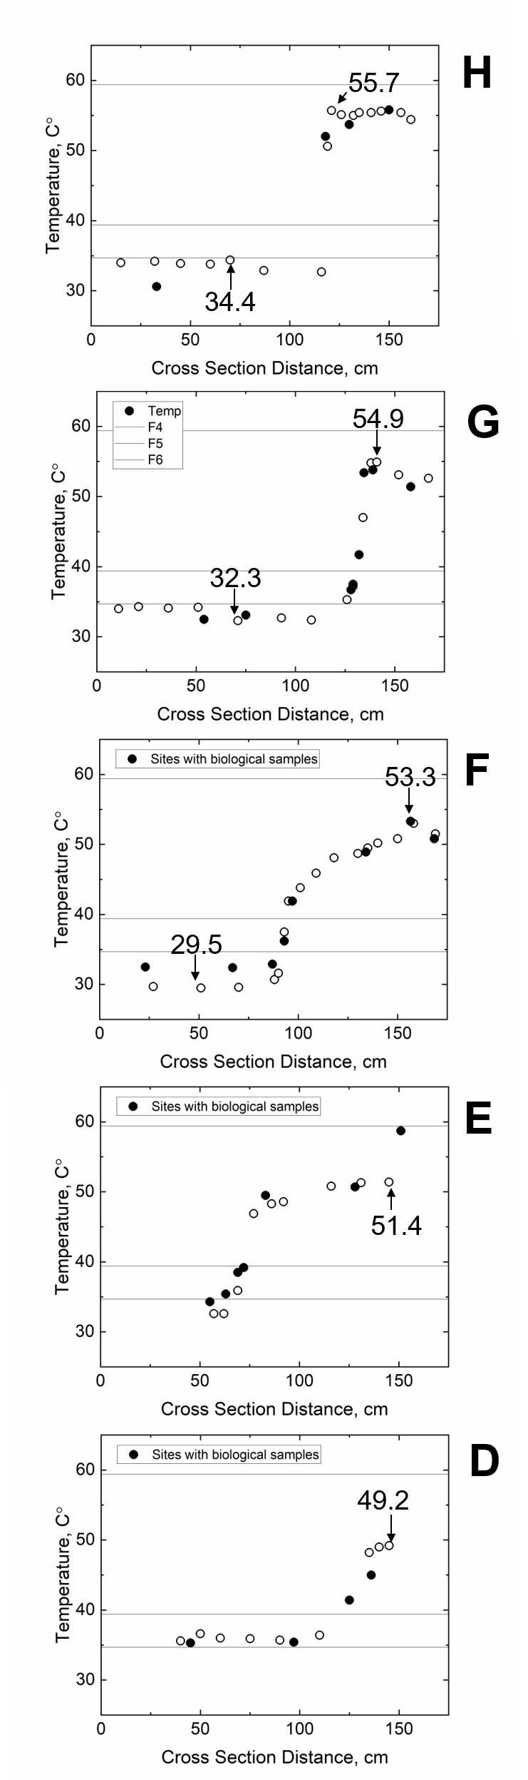
Measurements
Temperature data points were taken at points across each cross section as well as the sources.
Biological samples were collected at some points of the cross section.
    Represented by the black points
Chemical measurements were collected at both source locations as well as the downstream mix.
2m

Slide 6
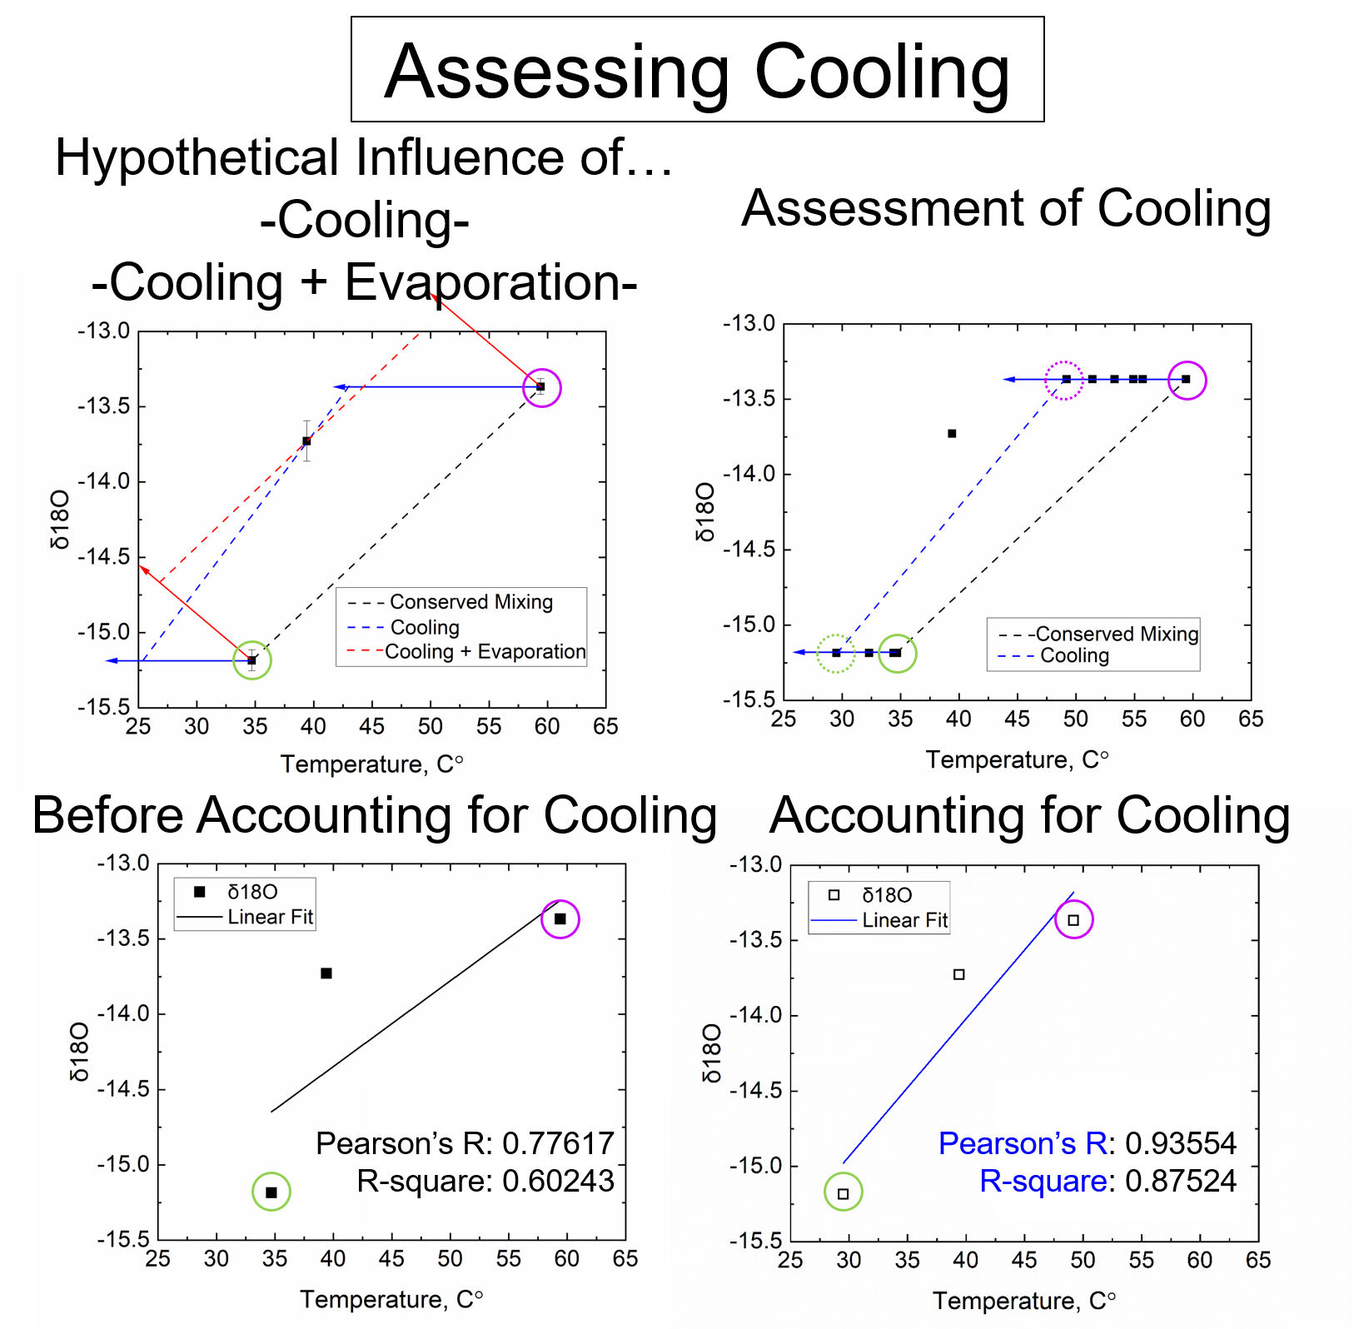

Slide 7
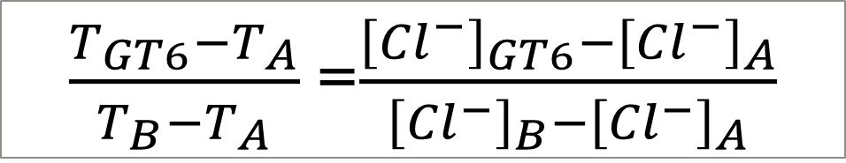
Estimate [Chemical Constituent]
$\frac{T_{GT6}−T_{A}}{T_{B}−T_{A}}$=$\frac{{\left[{Cl}^{−}\right]}_{GT6}−{\left[{Cl}^{−}\right]}_{A}}{{\left[{Cl}^{−}\right]}_{B}−{\left[{Cl}^{−}\right]}_{A}}$

Slide 8
Estimating [Reactants]
Cross Section G

Slide 9
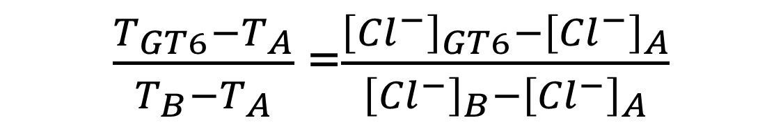

Estimated chemical energy
Methane Oxidation:
Ammonia Oxidation:
$${CH}_{4}+2O_{2}↔{CO}_{2}+2H_{2}O$$
$${NH}_{3}+2O_{2}↔{NO}_{3}^{−}+H_{2}O+H^{+}$$
$\frac{T_{GT6}−T_{A}}{T_{B}−T_{A}}$=$\frac{{\left[{Cl}^{−}\right]}_{GT6}−{\left[{Cl}^{−}\right]}_{A}}{{\left[{Cl}^{−}\right]}_{B}−{\left[{Cl}^{−}\right]}_{A}}$
Notes:
r10 8e -1 METHANE,AQ -2 O2,AQ 1 CO2,AQ 2 H2O
r5 8e -1 NH3,AQ -2 O2,AQ 1 NO3- 1 H2O 1 H+

Slide 10
Distribution of aerobic methane oxidizers, methanotrophs
-16S rRNA gene amplicon sequencing-
NH3/NH4+ can competitively inhibit the enzyme involved in the first step of aerobic methane oxidation
At > 50C, steep increase in energy for ammonia oxidation
Methanotrophs not detected at sites > 50C
Ammonia oxidation may start to have an inhibitory effect at > 50C sites
  Alternative hypotheses:
    Temperature
    pH

Slide 11
Future Plans
    Create all the plots and analysis shown today for each cross section
    Currently the main factor considered in the analysis has been the cooling temperature down the outflow. Eventually we will create an evaporation model as well.
    Use ArcGIS to map out the biology on an energetic and geochemical landscape

Slide 12
Acknowledgements
A very special thank you to Alta Howells for all the time and effort put into helping with this project. Thank you to Everett Shock for mentoring and guiding me through the research and thank you to everyone in the GEOPIG research group for their assistance and support. And special thanks to the Arizona Space Grant Consortium for the opportunity.

Slide 13
Thank You for Listening!

